Slide 1
DRIVER DROWSINESS DETECTION

Slide 2
INTRODUCTION
Driver fatigue is the major reason why half (50 %) of road accidents takes place. It is an interesting challenge in today’s date to detect drowsiness in order prevent accidents.
The aim of this project is to detect drowsiness of Automobile Driver using various detection function and Voila Jones Algorithm.

Slide 3
PROPOSED WORK
IMAGE ACQUISITION:
It mainly involves obtaining the image of the Automobile driver. Live image is taken as its input and then it converts those images into the series of images which are further proceed to make various operations.

Slide 4
PROPOSED WORK
MOUTH DETECTION:
After detecting the face and eyes of Automobile driver with the detection function, the mouth detection is done with the help of mouth detection function. This is be done with Voila Jones Algorithm.
DROWSINESS DETECTION:
Once the eyes of Automobile driver are detected, the drowsiness detection function detects whether the driver is drowsy or not, by taking into consideration whether the eyes are open or closed that is the state of the eyes and considering whether the mouth is open(yawning) or closed.

Slide 5
PROPOSED WORK
FACE DETECTION:
Face detection activity takes one of the frame at a time ‘t’ from frame grabber which later tries to detect the face of Automobile Driver in every frame. And it is done with the help of Vision Cascade samples.
EYE DETECTION:
After detecting the face of Automobile Driver with the face detection function, the eyes detection can be done with the help of eyes detection function. This is done using Voila Jones Algorithm.

Slide 6
DESCRIPTION
An image here is processed with the help of Viola Jones Algorithm.
In the first step, the face is detected and then the eyes and mouth are sectioned and are processed to detect drowsiness/ fatigue.
With the help of rectangular () measures the length and width of an eye and mouth. The position, length and width can be obtained with the help of Vision class.
‘Cascade Object Detector’ which is an inbuilt object detector in MATLAB is used to detect eye and mouth.

Slide 7
DESCRIPTION
The obtained image is then cropped using ‘imcrop( )’ command in MATLAB.
Colored image is converted into grey scale image using ‘rgb2grey( )’ function.
In order to create box, we used ‘bbox( )’ function.
‘imadjust( )’ help in adjusting the level of contrast. Accuracy of the project depends on the quality of Web-Camera. The processing time is increased with the ‘getsnapshot( )’ function in MATLAB. By defining the region of interest for detection is done by using Viola Jones Algorithm in order to reduce computational requirements of the system. Using MATLAB Image processing , drowsiness detection system is be explained.

Slide 8
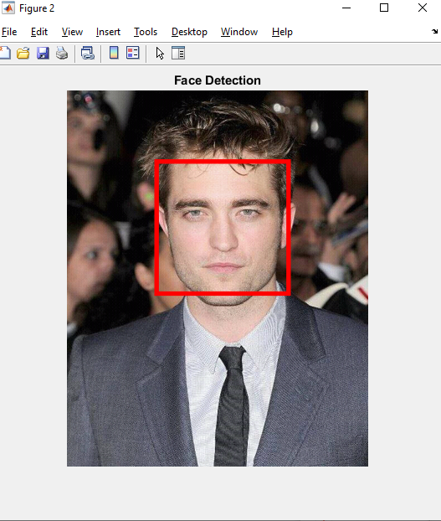

Slide 9
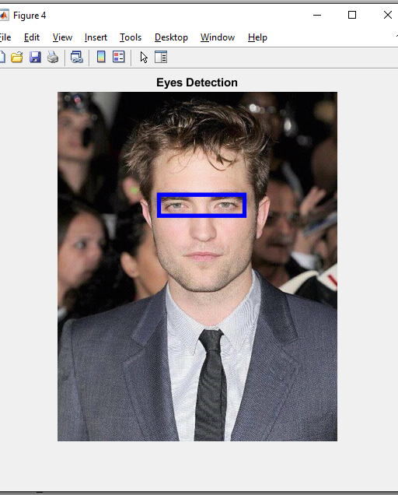
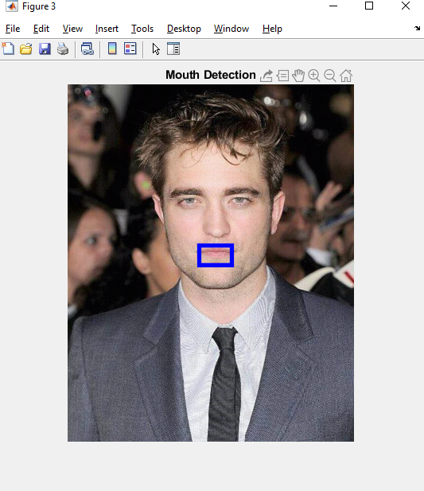

Slide 10
conclusion
In this way, we have successfully implemented drowsiness detection using MATLAB and Viola Jones Algorithm. The developed system has been successfully tested and its limitations are identified.
LIMITATIONS:
Limitations of the proposed system are as follows: If the driver is using sunglasses then the computation doesn’t work.

Slide 11
DEMO RESULTS

Slide 12
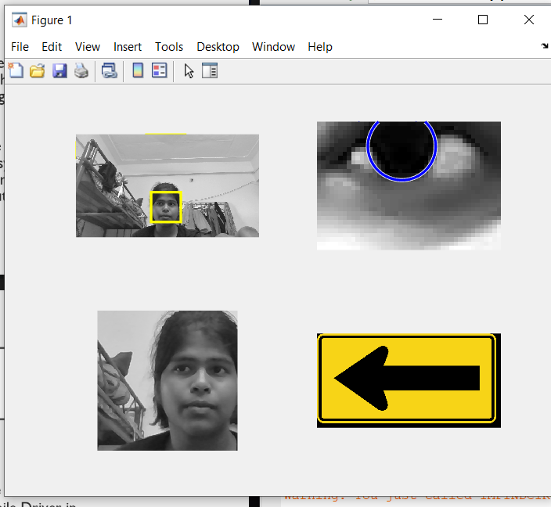
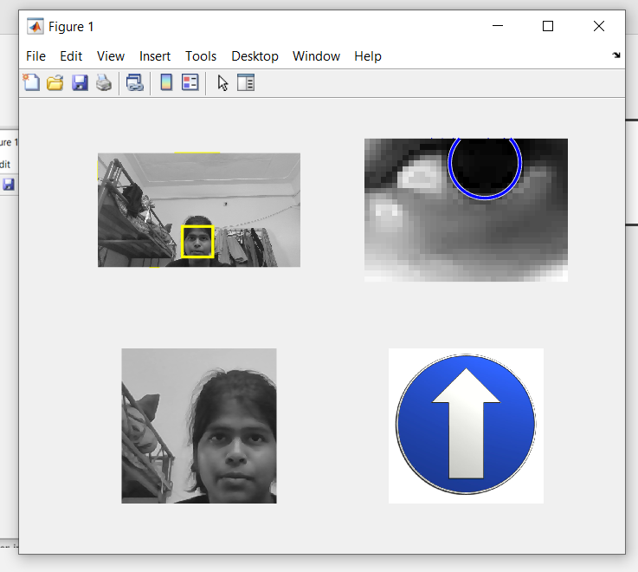

Slide 13
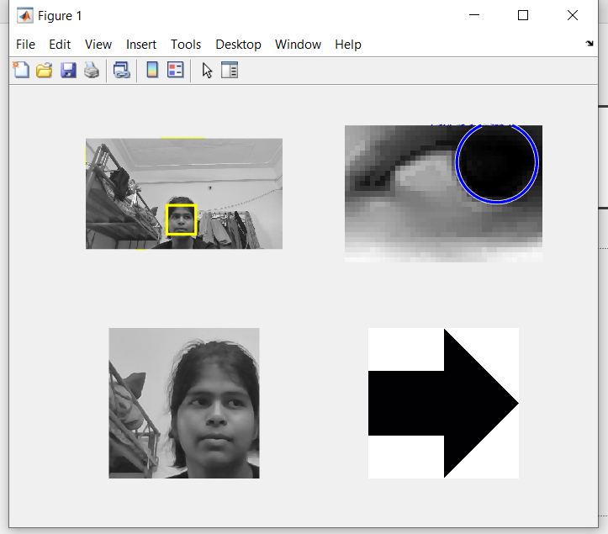
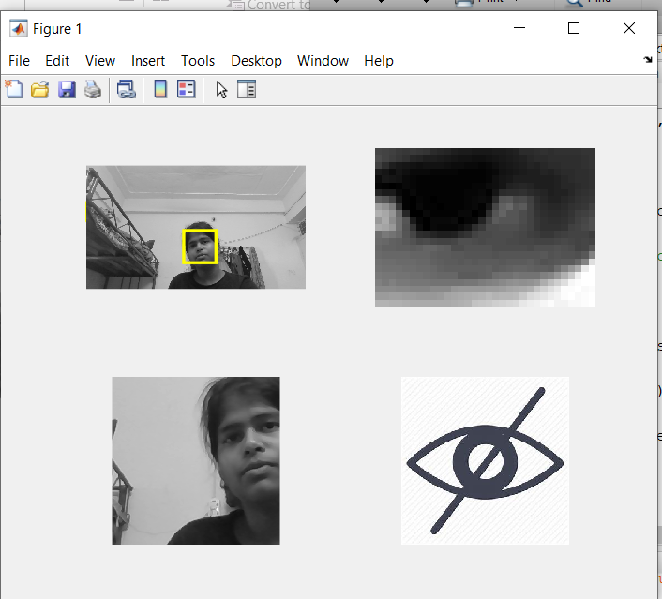
When a person is DROWSY.

Slide 14
THANK YOU!!
AKSHAYA A CB.EN.U4CSE17401
DIVYA RATHI CB.EN.U4CSE17416
GAYATHRI E CB.EN.U4CSE17420

